Slide 1

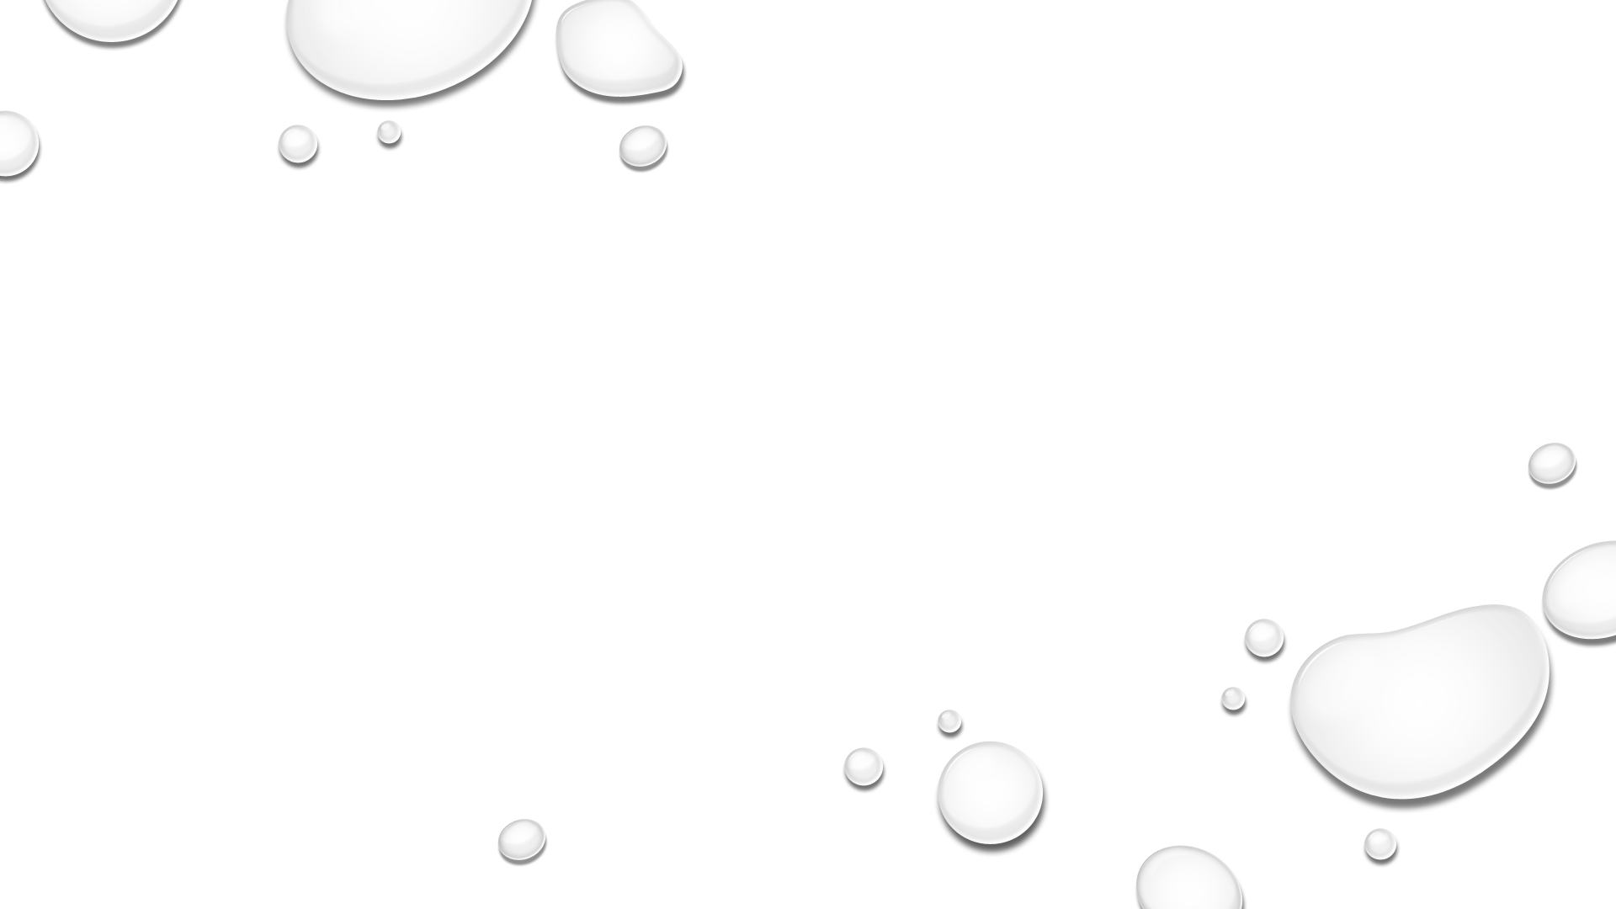


Norfolk Sister Cities in Collaboration with
Norfolk Public Schools, Presents:
Young Artists, Young Authors Showcase 2022
Generation Rescue: Sustainable Water for All

Slide 2
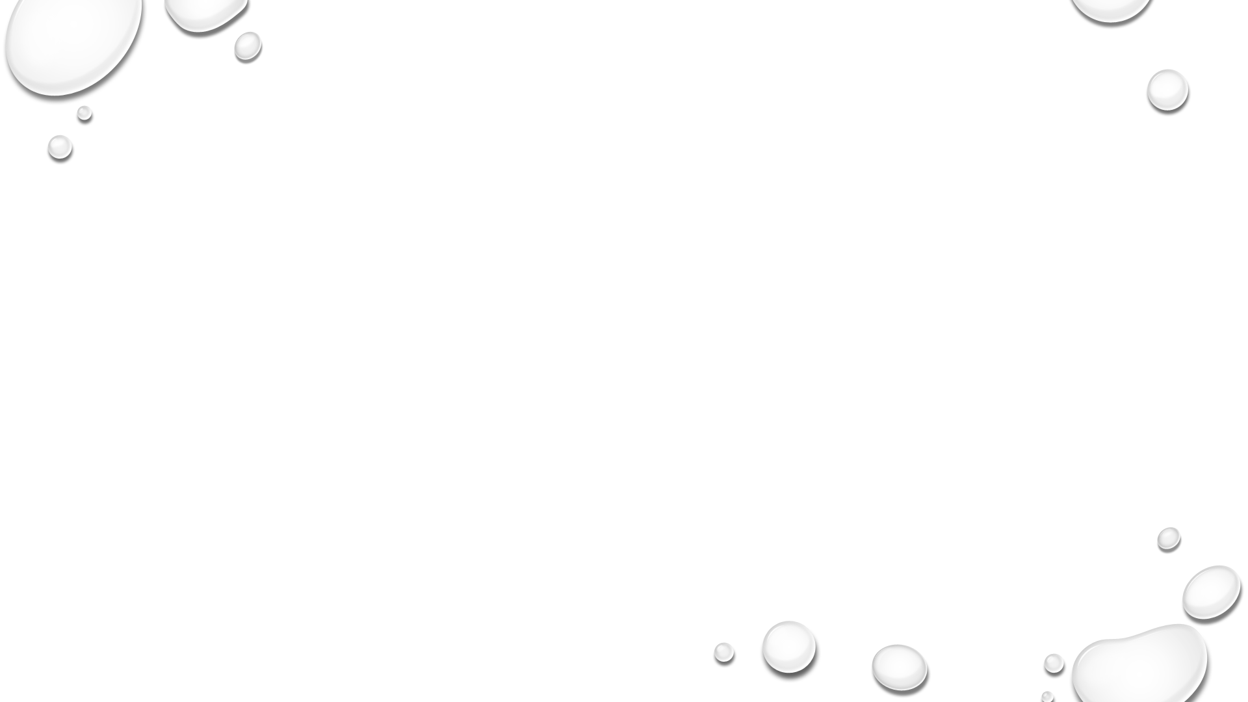

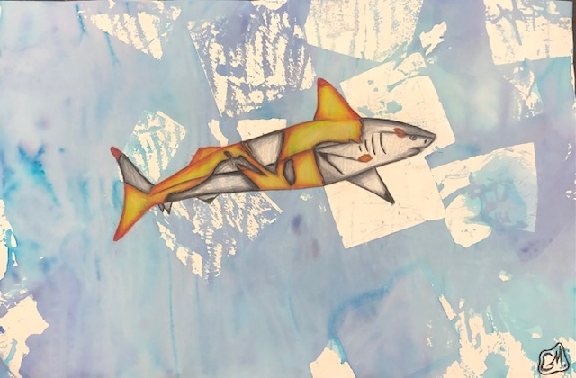
“Annulling Waters”​
Mixed Media ​
​
Jean/Ghost Shirai​
Northisde MS​
Grade 8​
​
Teacher: James Cipalla
Black tip reef sharks are medium sharks easily identifiable by the black tips on their fins. These sharks are highly important to the reef’s ecosystem. Being a part of the apex predators, Black Tip reef sharks are needed to maintain a functional system in their habitat. Black tip reef sharks are primarily found along the coastline of pacific regions such as Thailand, Japan and the Philippines. Black tip reef sharks prefer colder temperatures, but due to climate change affecting water temperatures they have learned to adapt to warmer, more tropical waters. Black Tip sharks are considered endangered. Their habitat and ecosystem are being affected by climate change drastically causing them to move to different types of reefs to adapt to the ecosystem and lack of food.
Climate change has massively affected the amount of black tip sharks migrating down the Atlantic coast to south Florida because of this the environmental health of this region has been posing a threat. Black tip sharks are proven to be needed to weed out and remove weak and sick fish species, helping to maintain and preserve coral reefs and seagrasses.
Notes:
“Annulling Waters”
Mixed Media
Jean/Ghost Shirai
Northisde MS
Grade 8
Teacher: James Cipalla

Slide 3
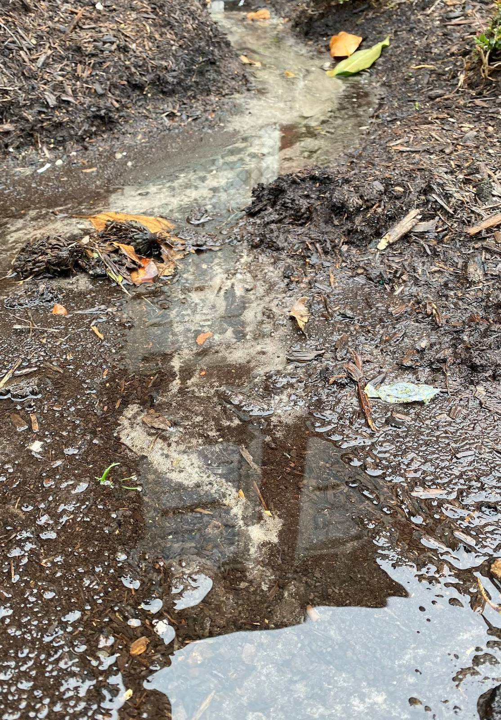
“Central Path”
Photography
Jazani Cox
Granby HS
Grade 11
Teacher: Nicole Harp
Water has value.
Water has power.
Water is needed everywhere for everything.
Water means more than you can ever imagine.
But what is the value without the care we bring to it?
Water we need respect, for the love and joy you bring to mankind.
We must clean and take care of the precise masterpiece.
Or do we like drinking what looks like part of the ground?
Notes:
“Central Path”
Photography
Jazani Cox
Granby HS
Grade 11
Teacher: Nicole Harp

Slide 4

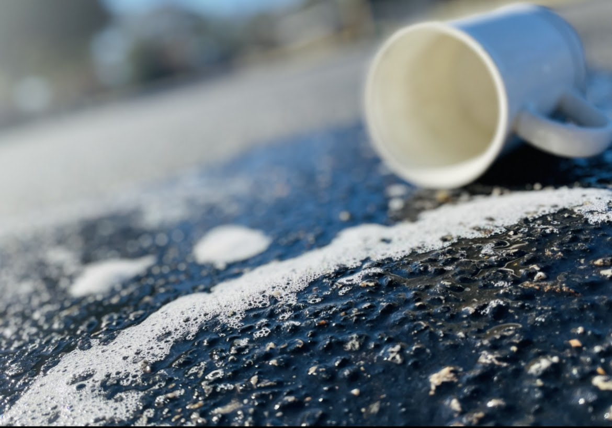
“Helpless”
Photography
Madison Skinner
Granby HS
Grade 10
Teacher: Nicole Harp
The inspiration of this photo came from knowing that it is up to my generation to save this planet or at least start making an effort towards saving our planet. When I was thinking of ideas of how I could portray my feelings of feeling empty and helpless of this water we might not have in a few years. I came down too showing a mug drained of water just like I feel about this issue while showing the water has feelings with the sad face of the bubbles.
Notes:
“Helpless”
Photography
Madison Skinner
Granby HS
Grade 10
Teacher: Nicole Harp

Slide 5
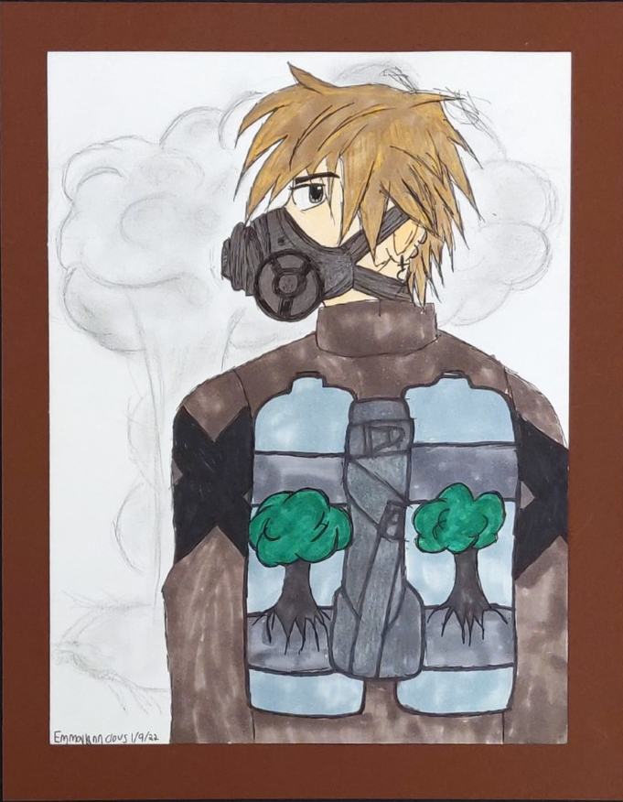
“Trees to Breathe”​
Drawing ​
​
Emmalynn Clous​
Azalea Gardens MS ​
Grade 8​
​
Teacher: Marjorie Kinney
My Inspiration for my artwork is that I just realized climate change does exist and climate change will make a lot of areas hotter, causing droughts and most likely killing trees because they aren’t getting enough water. Climate change might also cause radiation, polluting the amount of water left that we have. The trees in the air tank represent the only source we have of breathing because the air is so polluted, and radiation plays a part in that too. So there for we would be wearing gasmasks. The roots of the trees represent the lungs, another representation of our only breathing source. The main reasoning for no water in the picture is that there is none left because it got all polluted and people were wasteful with it, thinking we had plenty left.
Notes:
“Trees to Breathe”
Drawing
Emmalynn Clous
Azalea Gardens MS
Grade 8
Teacher: Marjorie Kinney

Slide 6

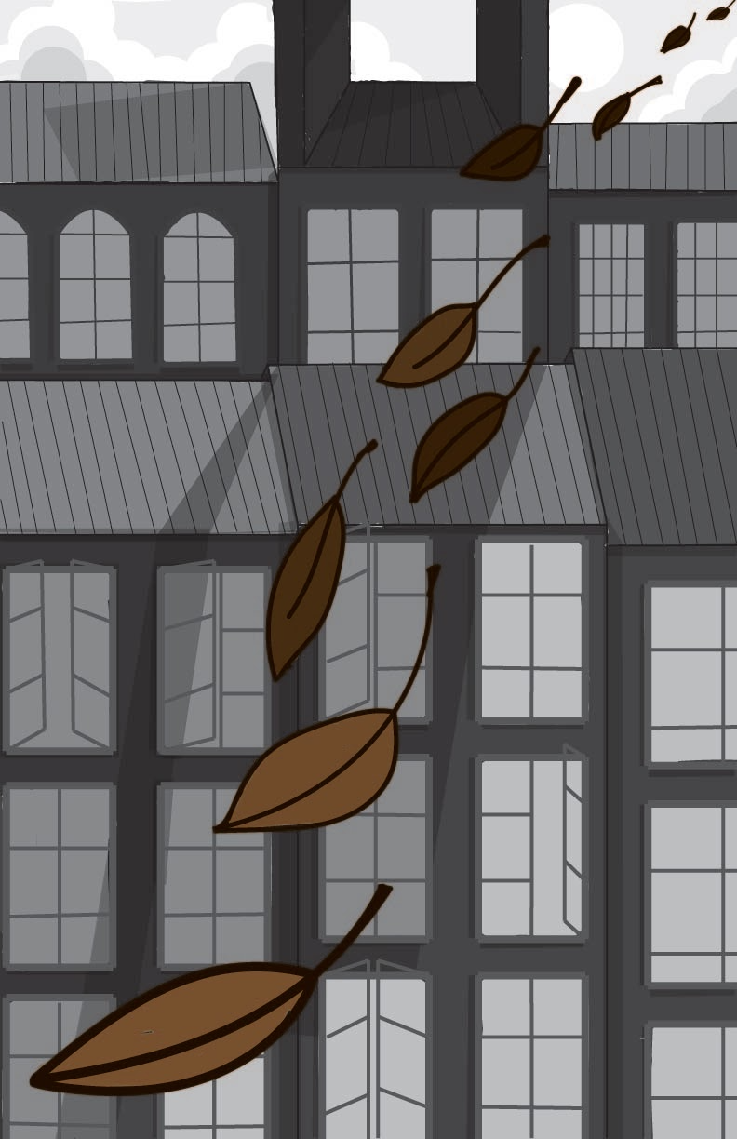
"When The City Sleeps”
Digital Painting
Ava Schlemmer
Booker T. Washington HS
Grade 11
Teacher: Jessica McClaire
I was inspired to create this piece because my focus was creating movement across the screen. I thought about how even when a city is quiet, and the people are asleep, there is often still movement, whether that be water, leaves, wind, etc. So, I thought about how I could portray this in an image, and I decided that the best way to do so was to use leaves that would be gliding across the screen.
Notes:
"When The City Sleeps”
Digital Painting
Ava Schlemmer
Booker T. Washington HS
Grade 11
Teacher: Jessica McClaire

Slide 7
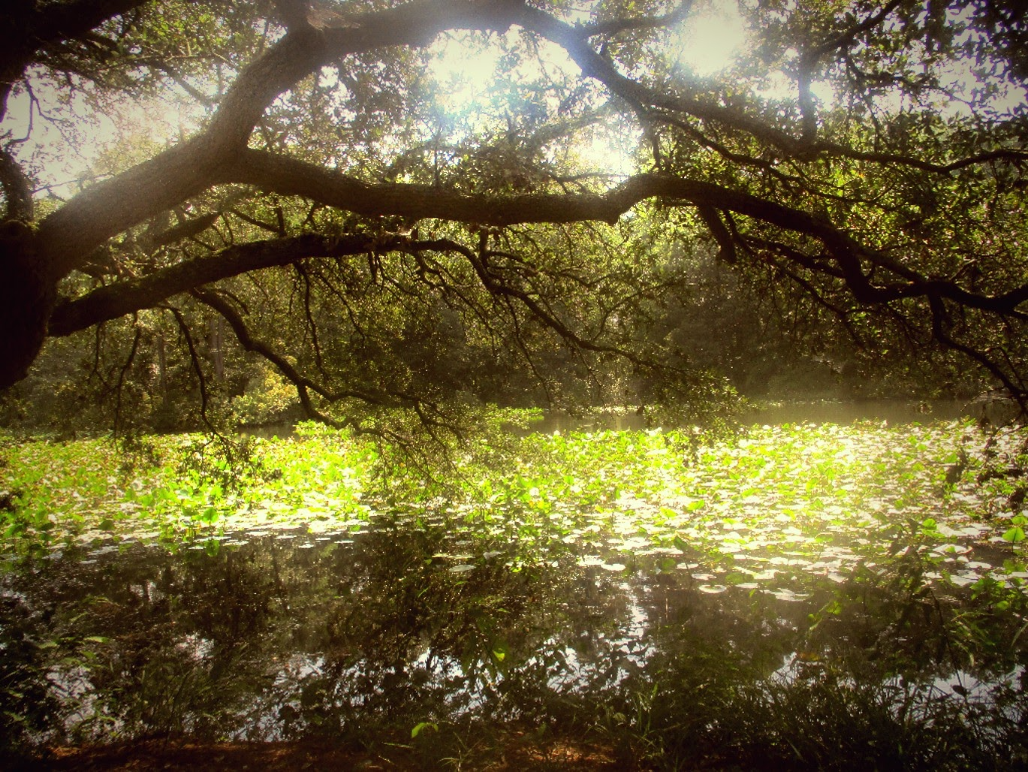
“Hide Away”​
Photography ​
​
Apollo Laureano​
Granby HS ​
Grade 12​
​
Teacher: Nicole Harp
On Earth the only drinkable water comes from Lakes, Springs, Rivers, and Wells. Those sources take up only a fraction of the water on earth, as most of Earth’s water is either stored in glaciers or the ocean. The only way our drinkable water can be replenished is through the Water cycle, which takes a while until it reaches completion.
During the summer of 2021 me and a couple of my friends went to The Norfolk Botanical Gardens, during that trip we came upon this beautiful pond that was placed in a little alcove. Due to Climate Change, there is a very real threat that such a beautiful place could be pumped dry to be used as drinking water when the places already used for water run out. Not many people realize that when you leave the sink running or flush, that your water will not be reused. Some places dump wastewater into the ocean, others dump it into a sewer to be dealt with later on. Most commonly places not near an ocean will dump into the nearest large body of water, like a lake or river. This pond could become a dump place for waste, and that could destroy the habitat. I hope that one day in the near future we can find a way to have sustainable water so that places like this can remain beautiful.
Notes:
“Hide Away”
Photography
Apollo Laureano
Granby HS
Grade 12
Teacher: Nicole Harp

Slide 8

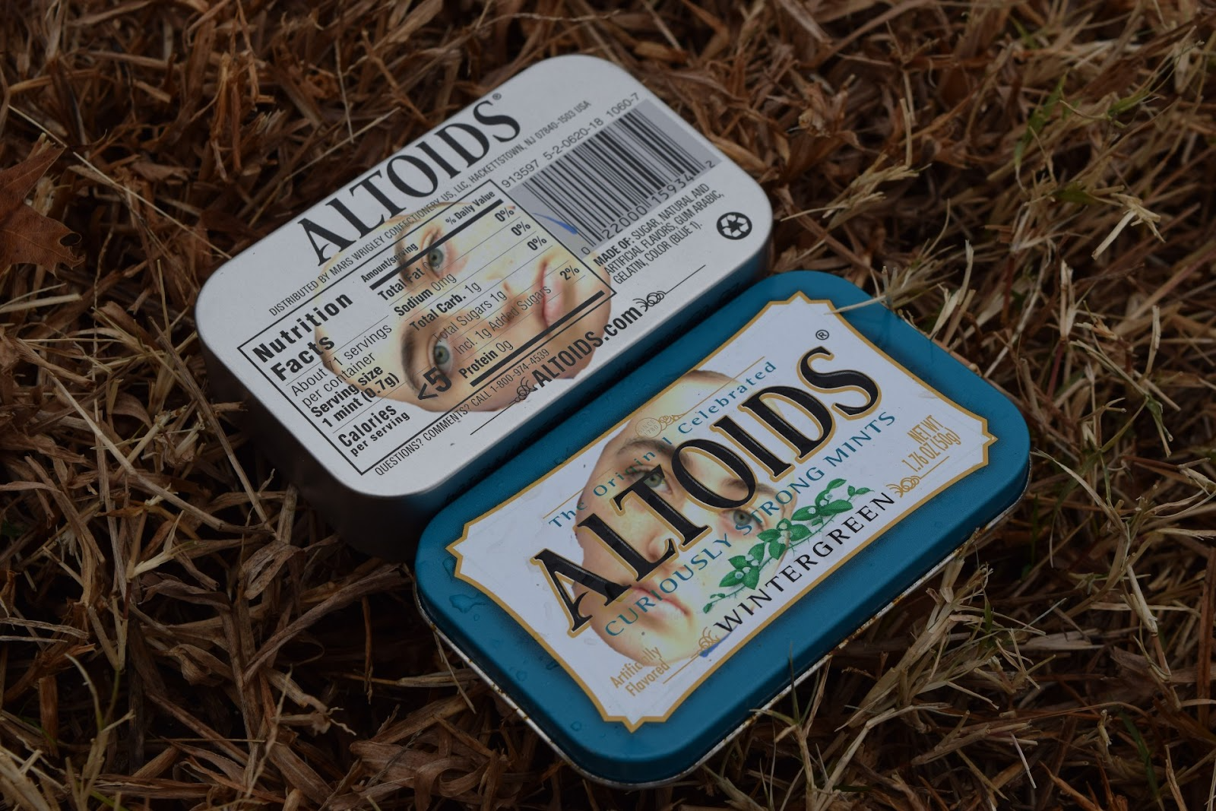
“Alytoids”
Photography
Alexis Caudell
Granby HS
Grade 11
Teacher: Nicole Harp
Pollution is a major problem our environment faces today. While on a walk outside, a majority of what caught my eye was different pieces of trash overtaking the beauty of nature. In this artwork, I took two separate photos- one of an Altoids container and the other a headshot of my friend, Aly. They were superimposed to create a chilling photograph to immerse the viewer in a state of anxiety or maybe sympathy for the trapped lady...This is how we should feel about the polluted world around us. The woman portrayed seems to be trapped and unhappy, as she’s now a random container laying in the gloomy grass. We should want to help- in a metaphorical sense “help” this trash-struck woman, or in a real sense by not littering and aiding in this pollution crisis in order to create a sustainable and healthy environment for all. The title, “Alytoids,” odes to the amalgamation of Aly and Altoids, making them one.
Notes:
“Alytoids”
Photography
Alexis Caudell
Granby HS
Grade 11
Teacher: Nicole Harp

Slide 9
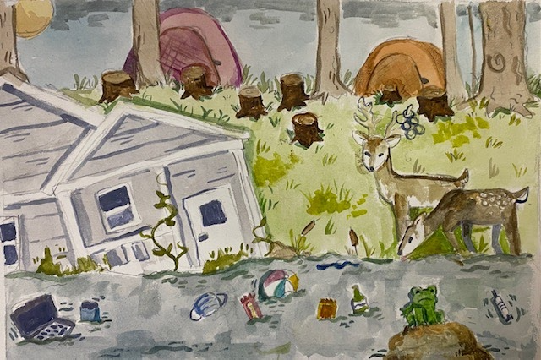
“Flooded House”​
Painting ​
​
Reagan Fussell ​
Blair MS ​
Grade 8​
​
Teacher: Meggin Watkins ​
​
Flooded House
This painting is about what I think the world will become if we don’t stop global warming.
I think towns will flood, houses will be destroyed, and trash will infest the water.
Notes:
“Flooded House”
Painting
Reagan Fussell
Blair MS
Grade 8
Teacher: Meggin Watkins

Slide 10
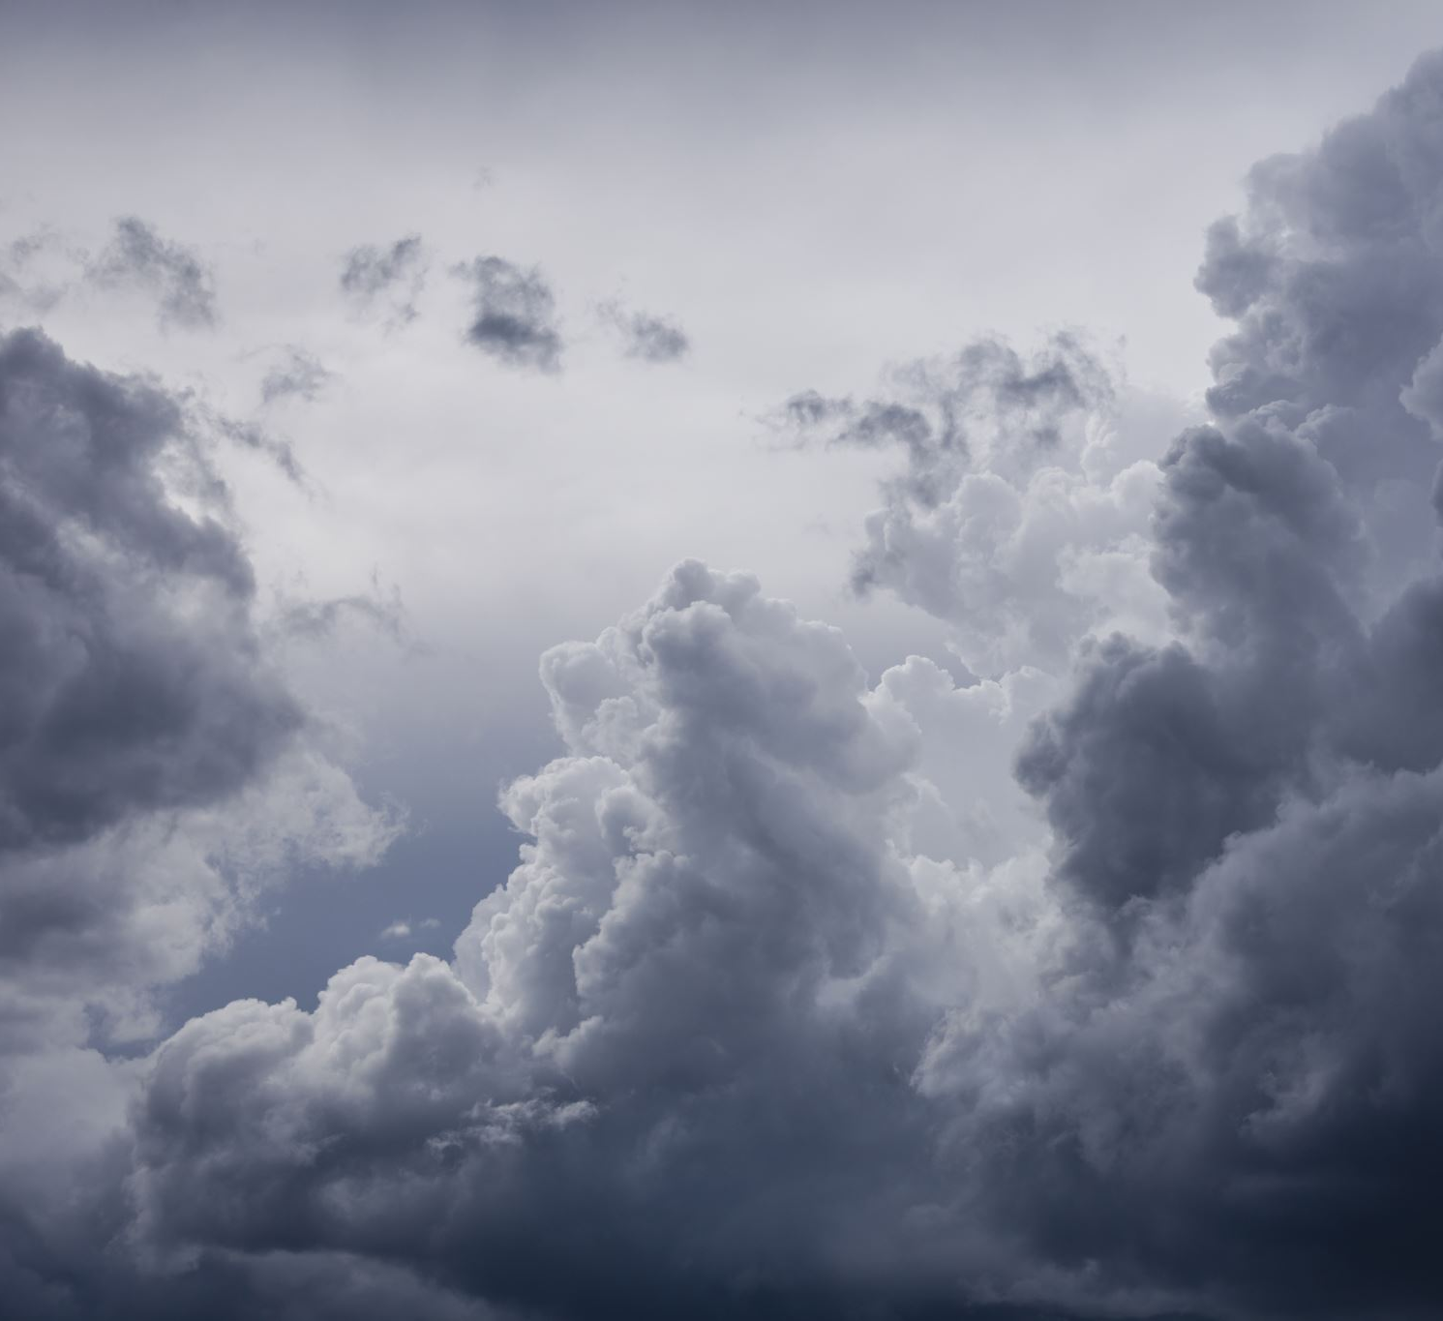
Waiting
Clouds form
Waiting in line for water to fall
Drip drip drip
But no downpour
That’s how it’ll feel down our backs
Drip drip drip
Clouds form
Thirsty for hydration
Anything that will quench our thirst for life
~Olivia Clay
“Waiting”
Poetry
Olivia Clay
Granby HS
Grade 11
Teacher: Nicole Harp
My poetry is about how we need water in order to thrive in our environment. Less water means that there'll be less clouds to gather up and rain on on our undependable earth. Water makes memories, extinguishes heat, and most importantly it sustains life. The clouds kind of represent us waiting for something to happen, but not doing anything to achieve that goal. We can dream it and think about it, but without a cause or motivation, nothing would get done. Water would never be a clean resource anymore.
Notes:
“Waiting”
Poetry
Olivia Clay
Granby HS
Grade 11
Teacher: Nicole Harp

